Slide 1
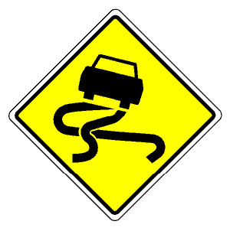
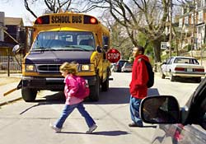
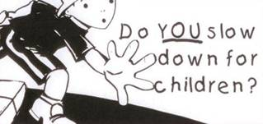
Introduction to road user safety
Traffic management and the Environment
Charles Musselwhite
Office: 3Q30
Charles.Musselwhite@uwe.ac.uk

Slide 2
Content
UK statistics on road user safety
Annual accidents
Over time
By mode
Gender and age
Older People
Children
Black and minority ethnic groups
Areas of high deprivation
Compared with EU
Collecting data: STATS 19
What STATS19 can tell us additionally
Causal factors

Slide 3
3. Road traffic injuries and death
In 2011 the Road Casualties in Great Britain Annual Report states:
There were a total of 203,950 casualties of all severities,
2 per cent lower than in 2010.
17 per cent lower than 2005-9 average
1,901 people killed
3 per cent increase from 2010,
32 per cent decrease from 2005-9 average
23,122 were seriously injured
Up 2 per cent on 2010 and
Down 15% from 2005-9 average
178,927 were slightly injured
down 3 per cent on 2010.
Down 17% from 2005-9 average

Slide 4
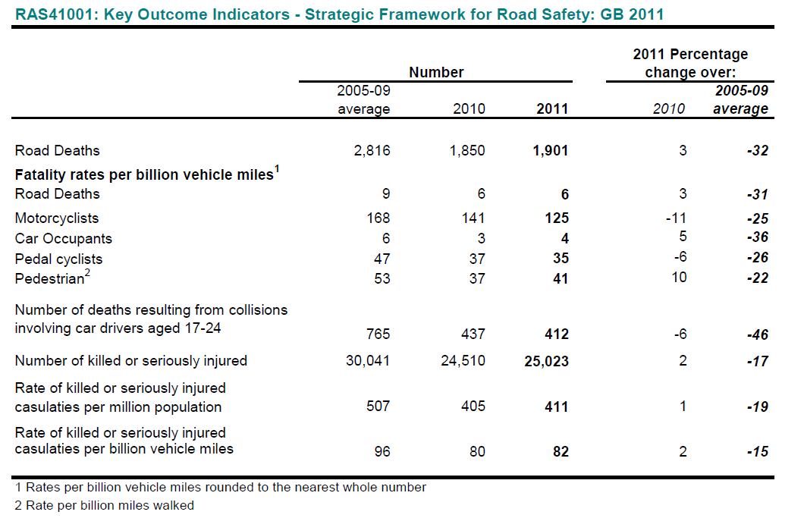
By mode

Slide 5
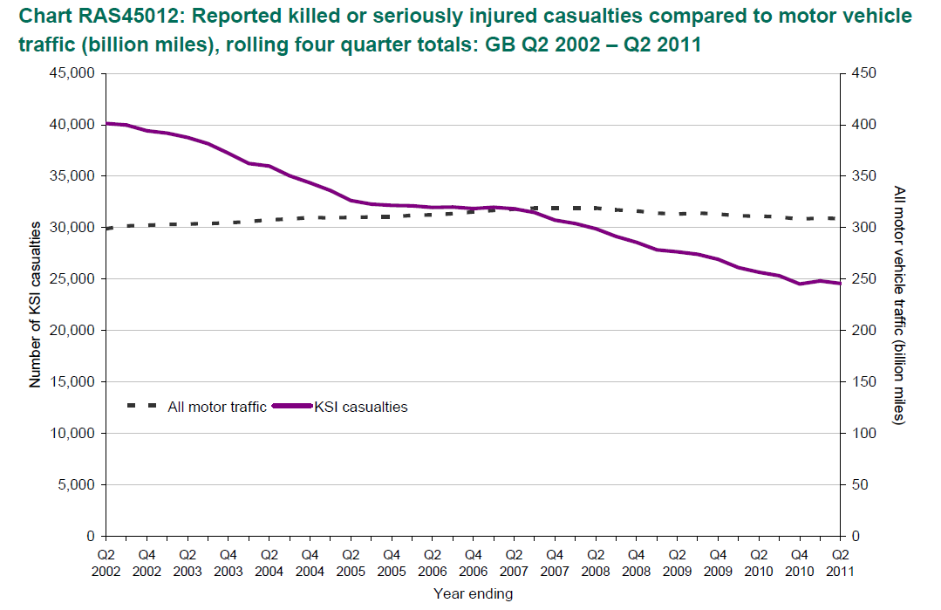
Compared to traffic

Slide 6
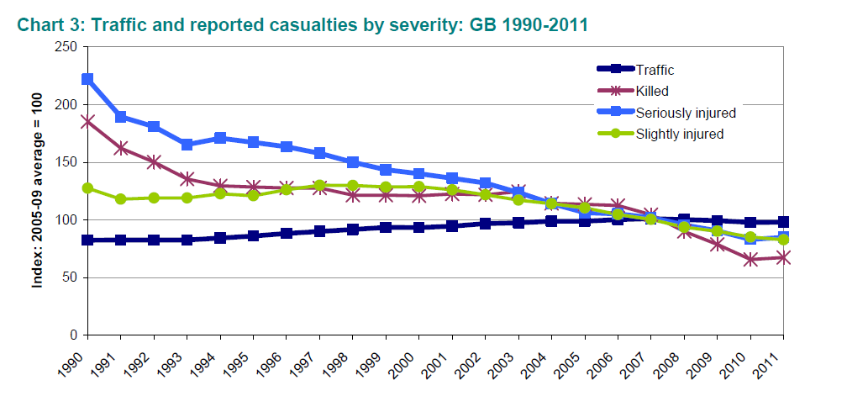

Slide 7
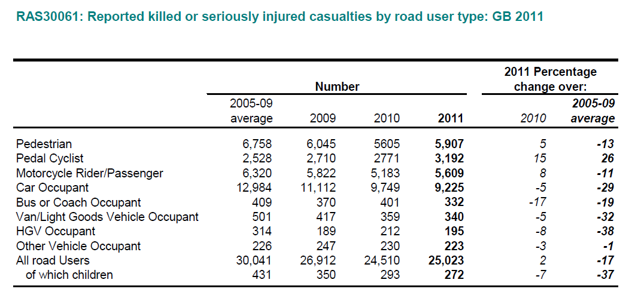

Slide 8
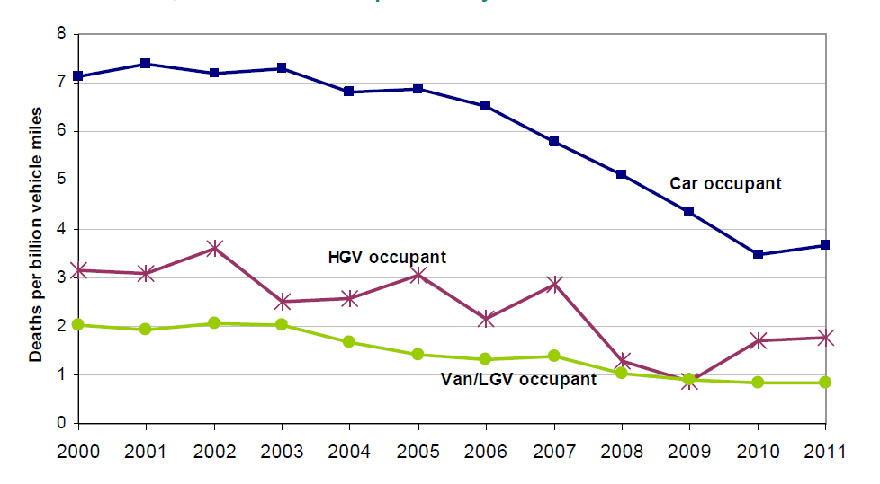
By mode

Slide 9
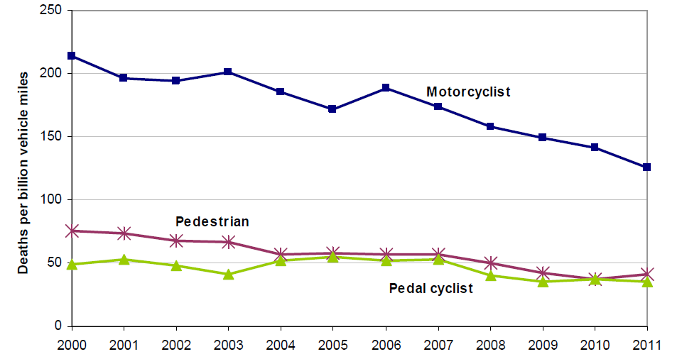

Slide 10
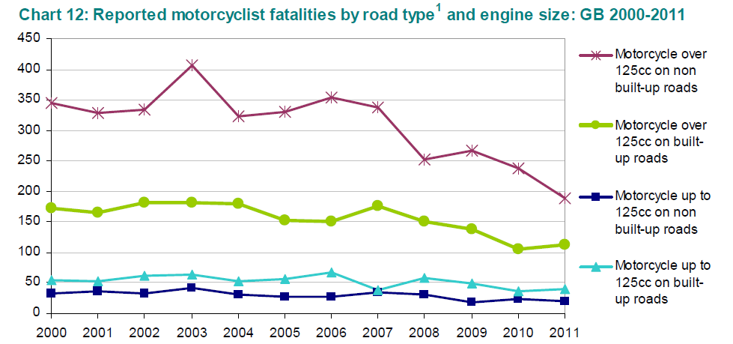
Motorcycling road user safety
Motorcycles = 20% of deaths, 1% of traffic
Non-built up roads and larger bikes esp. the problem.

Slide 11
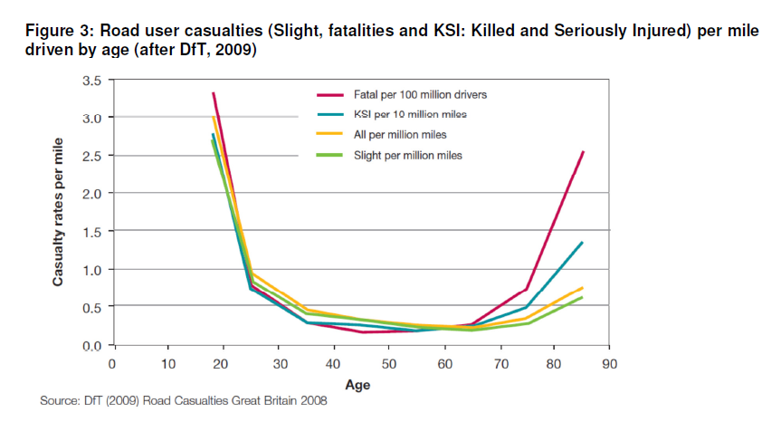
Road user casualties by age

Slide 12
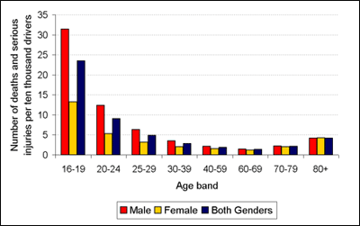
Road user safety and age and gender
AGE DIFFERENCES
The 16-29 age group accounts for over a third of all deaths on the roads
nearly 30% of all road deaths and serious injuries involve a young driver. In fact more than 3 young drivers a day are seriously injured or killed on the road – that amounts to 1,200 a year.
1 in 5 drivers crash in their first year of driving, and 1 in 3 young male drivers will write off a car in their first year of driving.
The graph shows the much greater crash rate of young drivers, especially males aged 16-19 years, compared with other age groups.

Slide 13
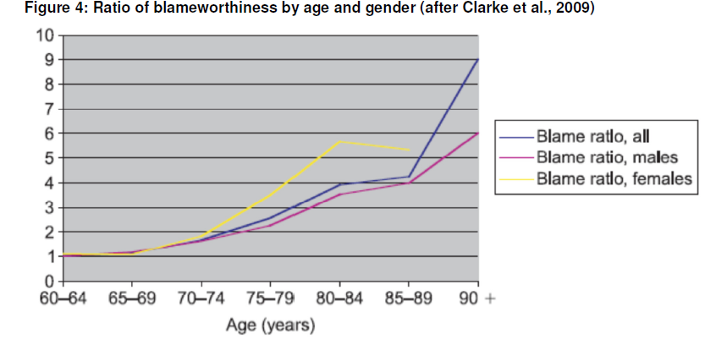
Older people and driving

Slide 14
Older people and driving
Slight increase in risk per mile driven
Frailty
Still an increase in at-blame accidents
Stereotype/attribution error
Older drivers are over represented in accidents:
• at Junctions;
• in merging traffic;
• with right-hand turns (when driving on the right-hand side of the road) and;
• in busy traffic (see Clarke et al., 2009 for review)
And mention having problems with:
• increased fatigue;
• poorer reactions (for example, on average, drivers over 55 take 22% longer to react than drivers under the age of 30 years) (DfT, 2001);
• difficulty with glare and luminance (average recovery time from glare, from lights from other vehicles or low sun for example, at age 16 is 2 seconds whereas at age 65 is 9 seconds and 75 year old driver requires 32 times the brightness to be able to see the same scene they did at age 25) (DfT, 2001) and;
• difficulty keeping a consistent constant speed (difficulty in detecting changes in feedback from the vehicle speed and difficulty in keeping foot pressed to the floor in the same position for long periods of time) (Musselwhite and Haddad, 2010a).

Slide 15
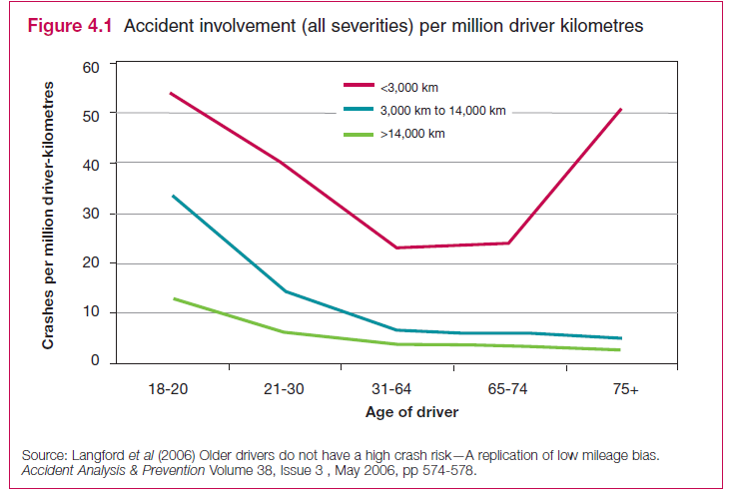
Older people and driving
Langford et al. (2006) suggest that low mileage drivers entirely make-up the increase in killed or serious accidents post 75 years of age.
Keeping driving, maintains skill practice and performance
Higher miles = more likely to drive on motorways or dual carriageways, the safer routes.
Self-selecting?

Slide 16
Older People and pedestrian road user safety
In the UK, there is a rise in the pedestrian accidents from late middle age, despite older people travel less than younger people (Dunbar, et al., 2004).
Although pedestrians aged 60 or above represent only 20.5% of the population, they account for 47% of pedestrian fatalities (Hakamies-Blomqvist, 2003).
More likely to walk
Frailty
The combination of physiological/cognitive/psychological aspects together with the socio-economic aspects of these group (low car ownership/use, accessibility needs etc.) expose elderly people to higher road accident risk.
Beatty and Parker (2007) identified the two biggest problems for older pedestrians as:
the poor condition of the pavement (uneven or slippery) and
the speed, volume and type of traffic.
In addition, difficulties crossing roads due to lack of safe crossings or lack of time to cross and the problem of pavements blocked by parked cars, bushes and other obstructions were also major problems

Slide 17
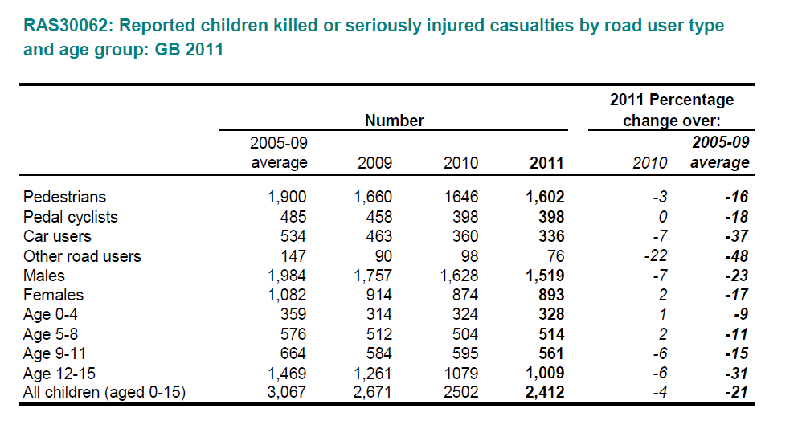
Children

Slide 18
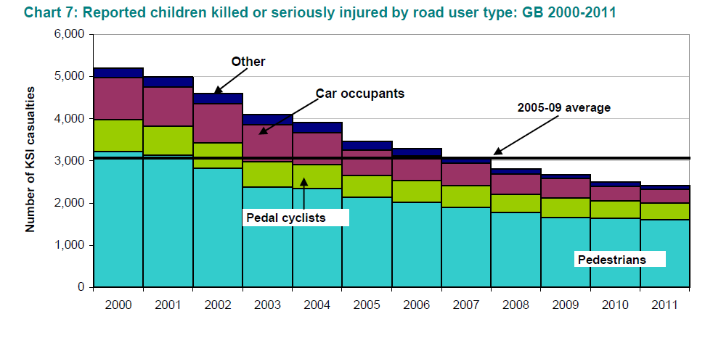
Children

Slide 19
Children and road accidents
Around 5,000 children under the age of 16 die or are seriously injured on Britain's roads each year
Nearly two in three road accidents happen when children are walking or playing
Almost two-thirds of child accident victims are boys
As a child gets older the risk of a road accident increases
A child from a low-income family is five times more likely than a child from a high-income family to be killed on the road
Children from an ethnic minority are involved in up to twice as many accidents while walking or playing as the national average
The risk of being involved in a road accident when walking or playing is more than 10 times greater for a child with hearing difficulties
The number of children killed and seriously injured on the roads has declined steadily for many years.

Slide 20
Black and Minority Ethnic Groups
Traffic accident studies have found significant differences in accident risk rates based on ethnicity (see White et al., 2000).
A review of road user accidents amongst ethnic minorities in a variety of countries, including United States, Sweden, Israel, Singapore and New Zealand, suggests children of ethnic minority background do suffer substantially increased risk of pedestrian injury relative to the norms for the country as a whole (Thomson and Tolmie, 2001).
In the UK, children of Asian ethnic origin appear to be disproportionately vulnerable (Kimberlee and Towner, 2007).
As White et al. (2000) suggests - per head of population, those young pedestrians of Asian origin aged 0-9 years were over-represented in road accidents by a factor of 2. Further research into ethnicity and road user safety is obviously required.

Slide 21
Road user safety and deprivation
Noland & Quddus, 2004 reports the positive correlation between area deprivation and traffic casualties. Their results show that areas that have higher IMD (Index of Multiple Deprivation)[ scores (i.e., are more deprived) are associated with increased serious and slight injuries from road traffic accidents.
Grayling et al. (2002) also addressed the relationship of different aspects of deprivation on adult and child pedestrian casualties and concluded:
Income, health and education deprivation was strongly associated with more child pedestrian casualties and less strongly associated with more adult pedestrian casualties
Housing deprivation is strongly associated with both more child and more adult casualties.
Employment deprivation is strongly associated with fewer child pedestrian casualties but more adult pedestrian casualties. This is explained by the notion that in areas of high unemployment there would be less traffic but unemployed adults might spend more time as active pedestrians.
Accessibility deprivation is associated with fewer child and adult pedestrian casualties, which is explained by the notion that there is likely to be more traffic and pedestrian activity in areas where there are more shops and services accessible.

Slide 22
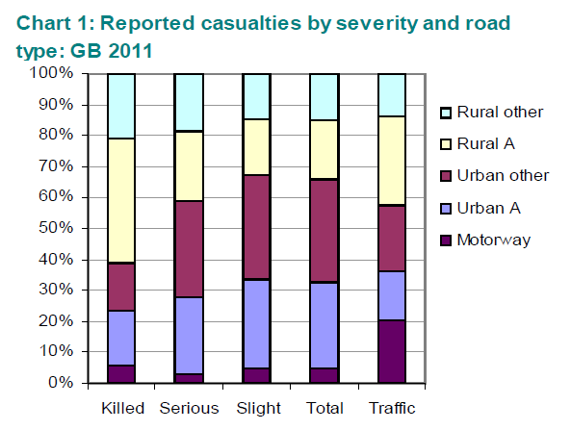
By road type

Slide 23
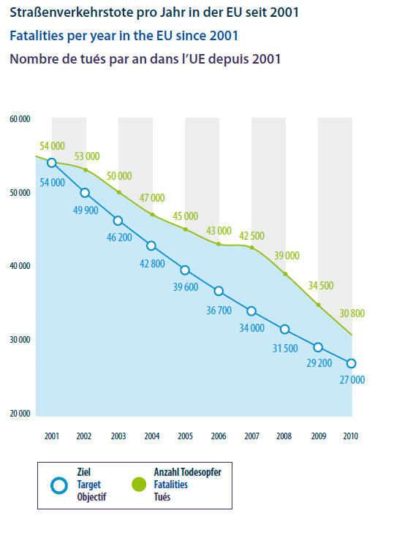
EU and road user safety

Slide 24
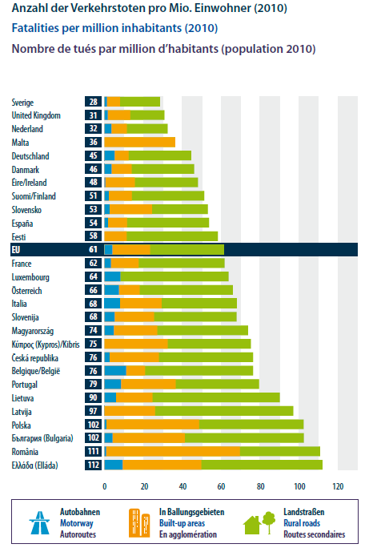
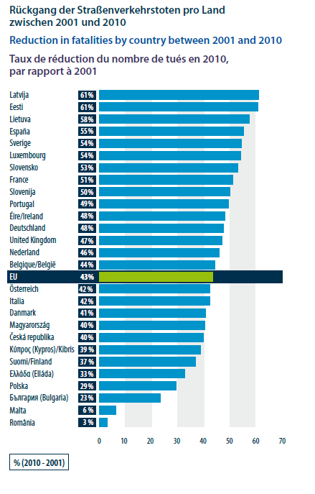

Slide 25
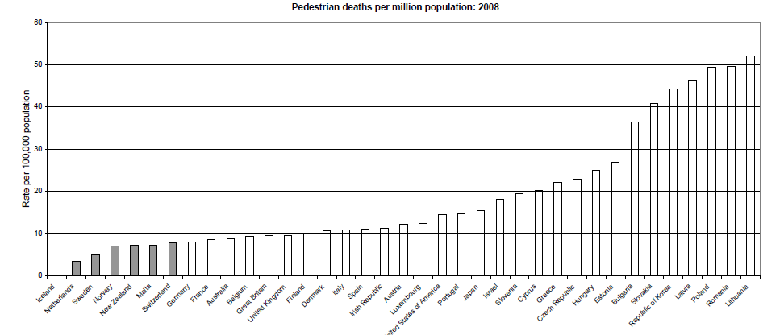
UK and Europe pedestrian deaths

Slide 26
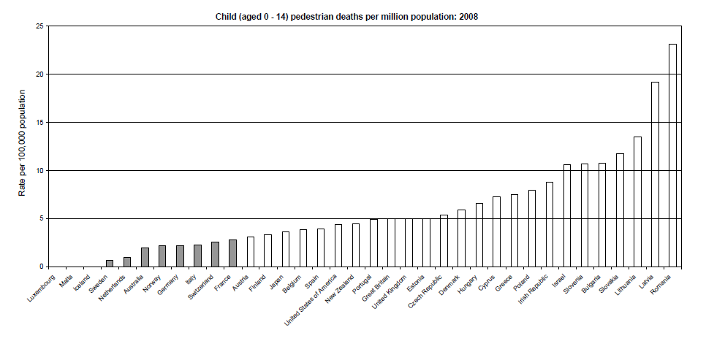
UK and Europe child pedestrian deaths

Slide 27
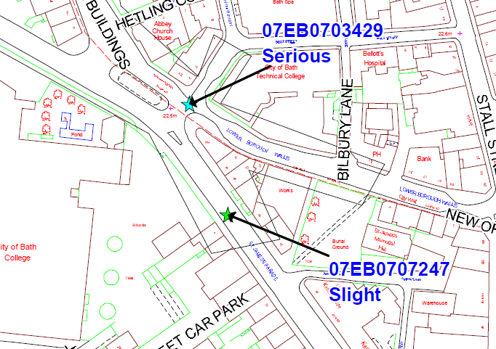
Capturing the data: STATS19
Data does not match very well to hospital admissions (33% the same!)
Does not capture all slight casualties
Subjective statements
Comprehensive, consistent reporting system

Slide 28
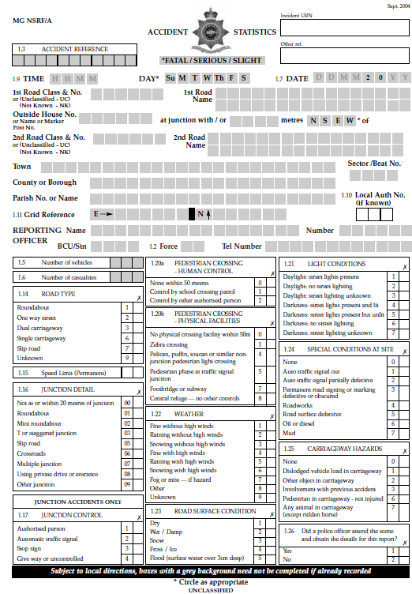
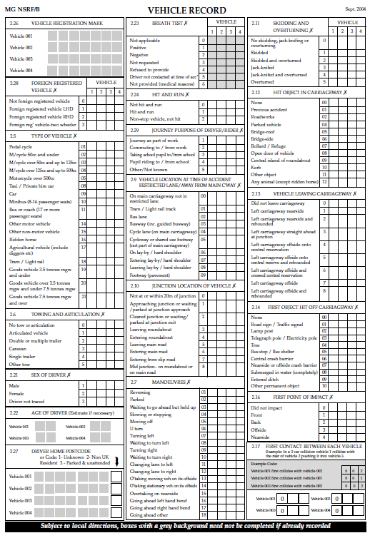

Slide 29
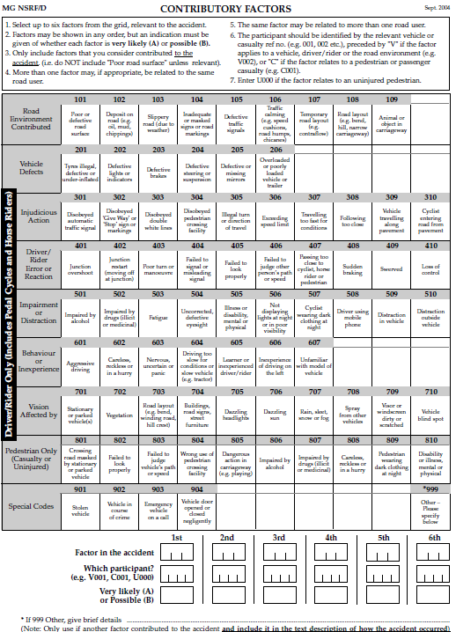
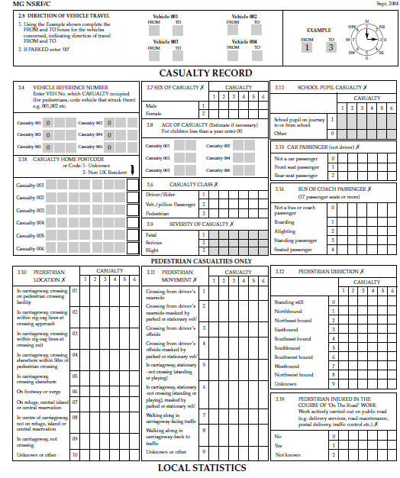

Slide 30
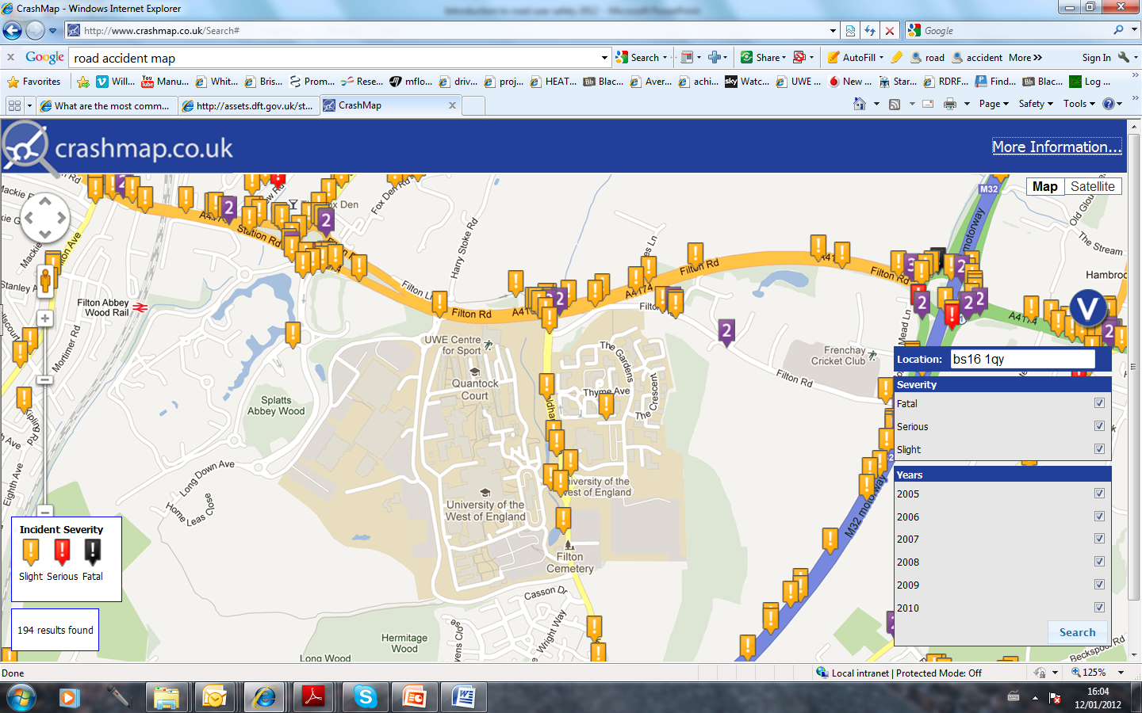

Slide 31
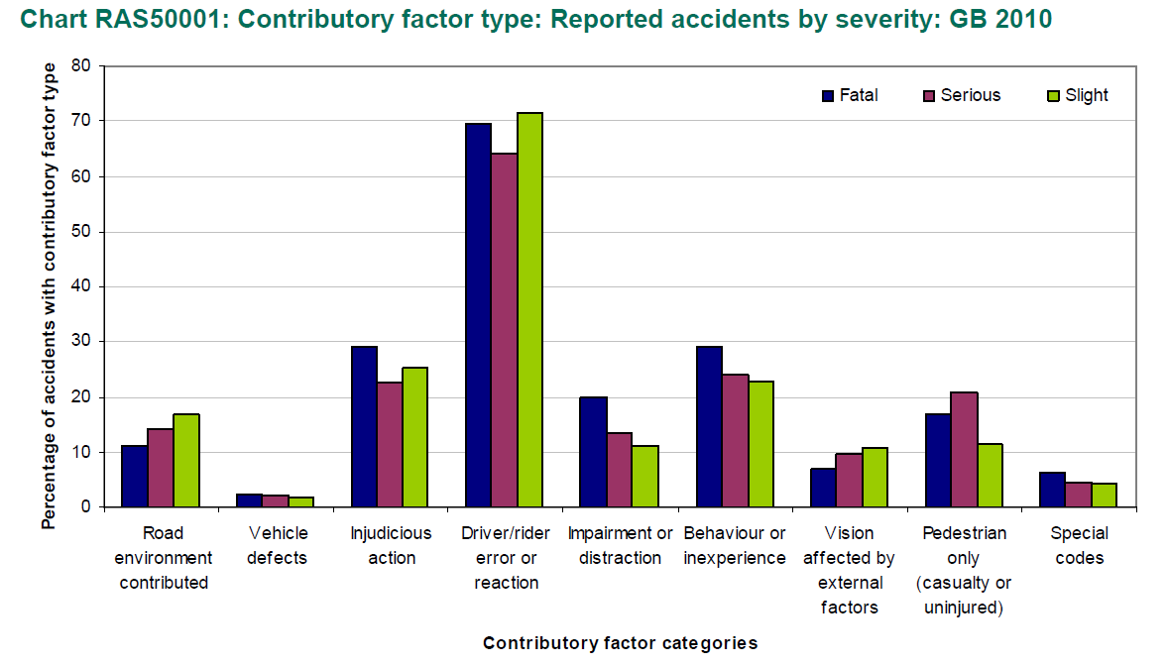
Contributory factor

Slide 32
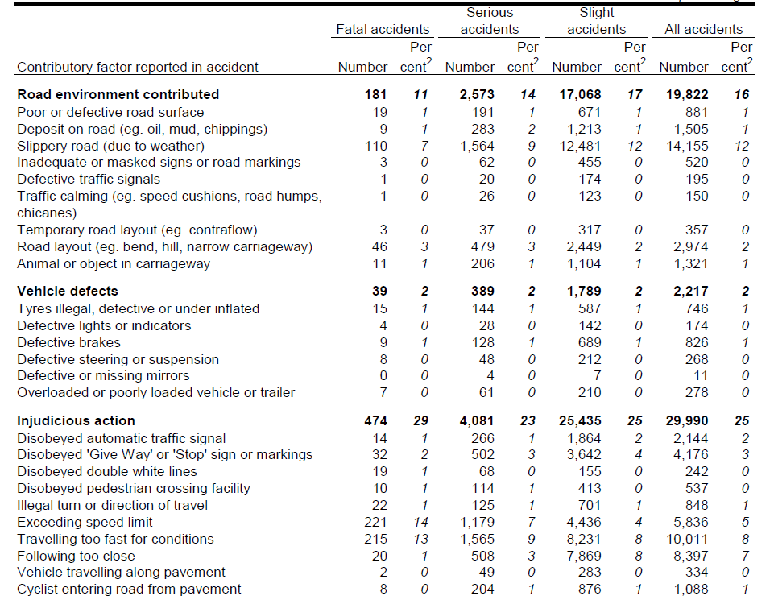

Slide 33
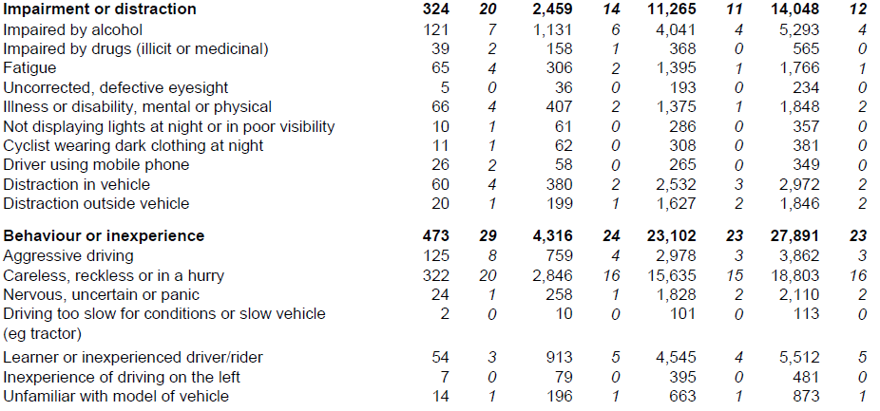

Slide 34
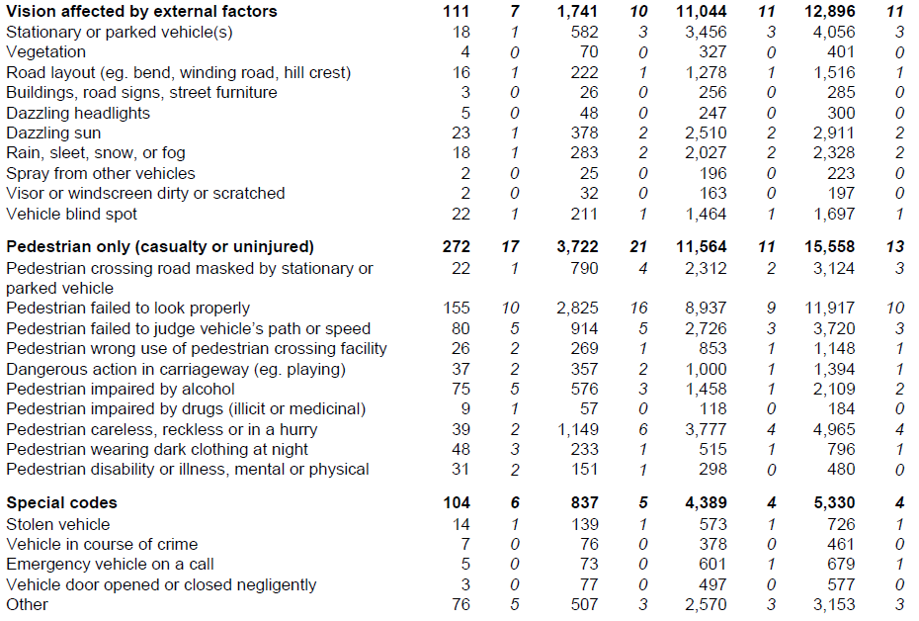

Slide 35
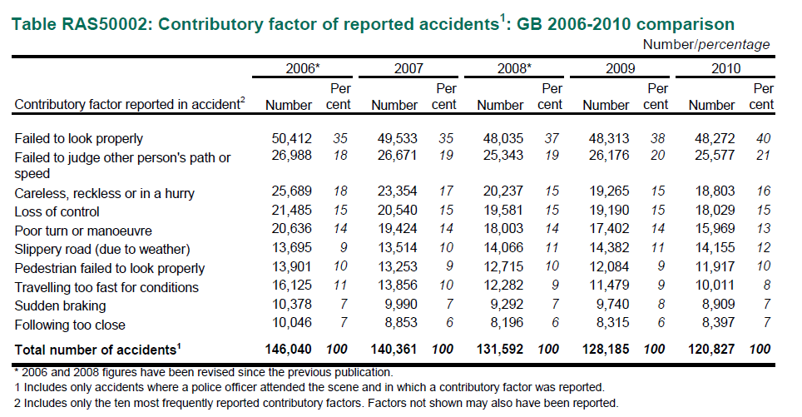
Driver error is crucial
14% of all deaths result from vehicle travelling too fast
4% of all accidents involve alcohol – 121 deaths (7%)
Using mobile phone – 21 deaths (2%)

Slide 36
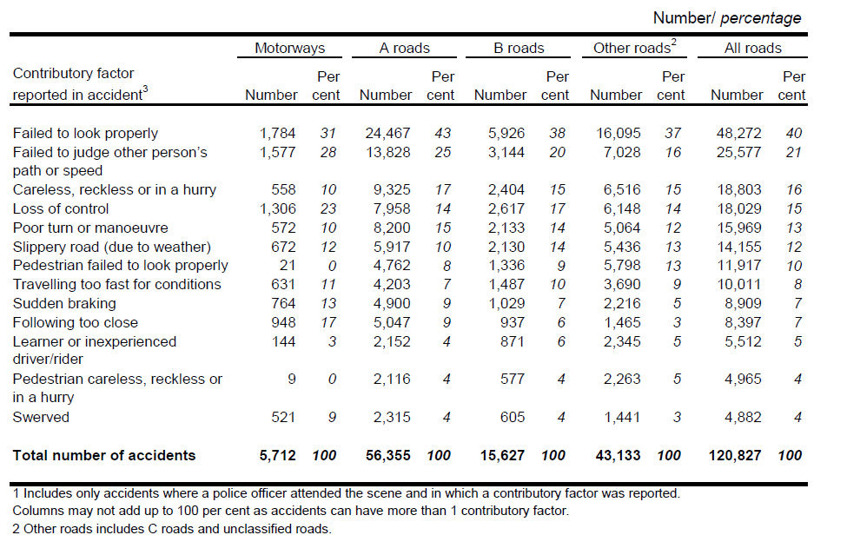
Causes of accidents and road type

Slide 37
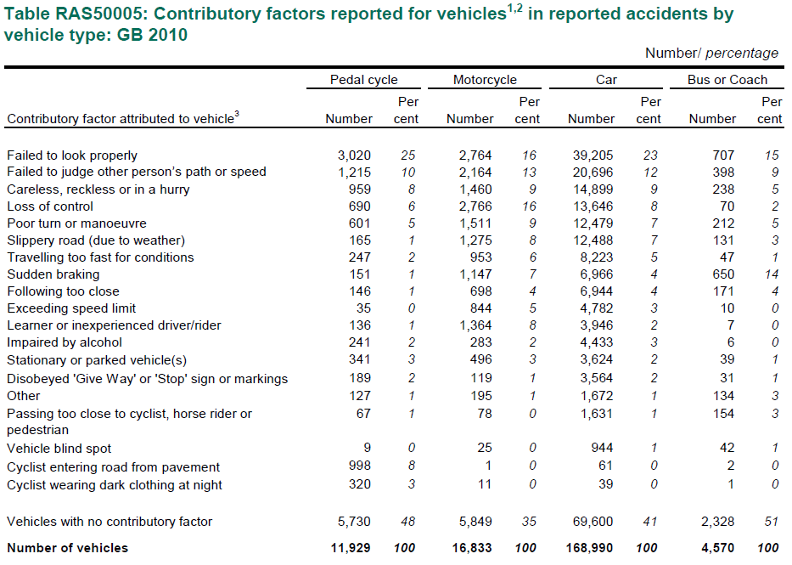
Causes of accidents by vehicle type

Slide 38
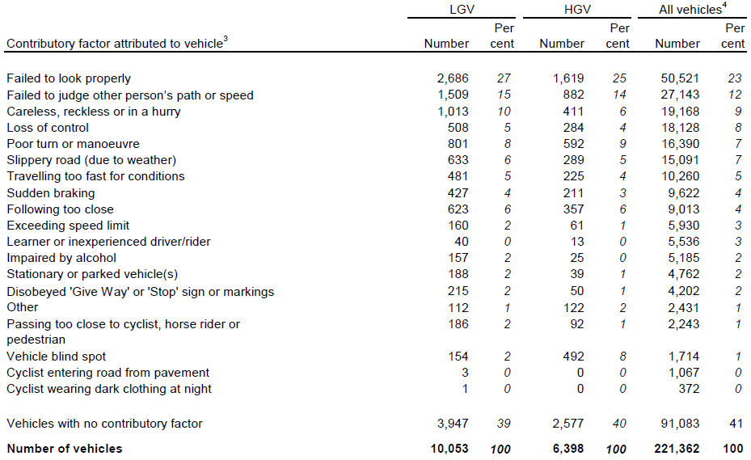
Causes of accident by vehicle type

Slide 39
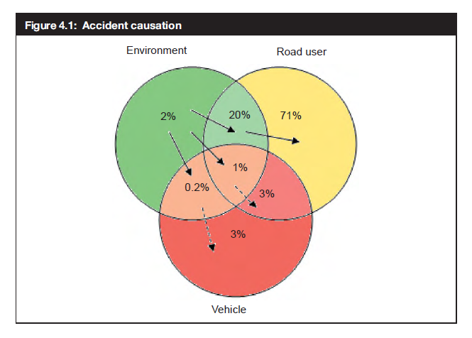
Road casualty causation
ROAD USER (95%)
Skill
Experience and development
Training
Attitude
Norms and peer pressure
Education, enforcement
Infrastructure
Engineering
Causes of road casualties
SKILLS
ATTITUDES
ROAD ENVIRONMENT

Slide 40
Conclusion
Casualty reduction improvements year on year
Key problems remain:
children pedestrian accidents
Younger drivers
Motorcyclist deaths
Deprivation
Rural areas
Data collected by STATS19 form
Driver error is key to problem
Skills
Attitude
Solutions?
Reference
DfT (2012)., Reported Road Casualties 2011. Available via https://www.gov.uk/government/publications/reported-road-casualties-great-britain-main-results-2011

