Slide 1
Community Matters: are our communities ready for ageing: Getting out and about
Setting the scene – where are we now and where do we want to be
Dr Charles Musselwhite
Associate Professor/Reader in Gerontology
c.b.a.musselwhite@swansea.ac.uk
www.drcharliemuss.com

Slide 2
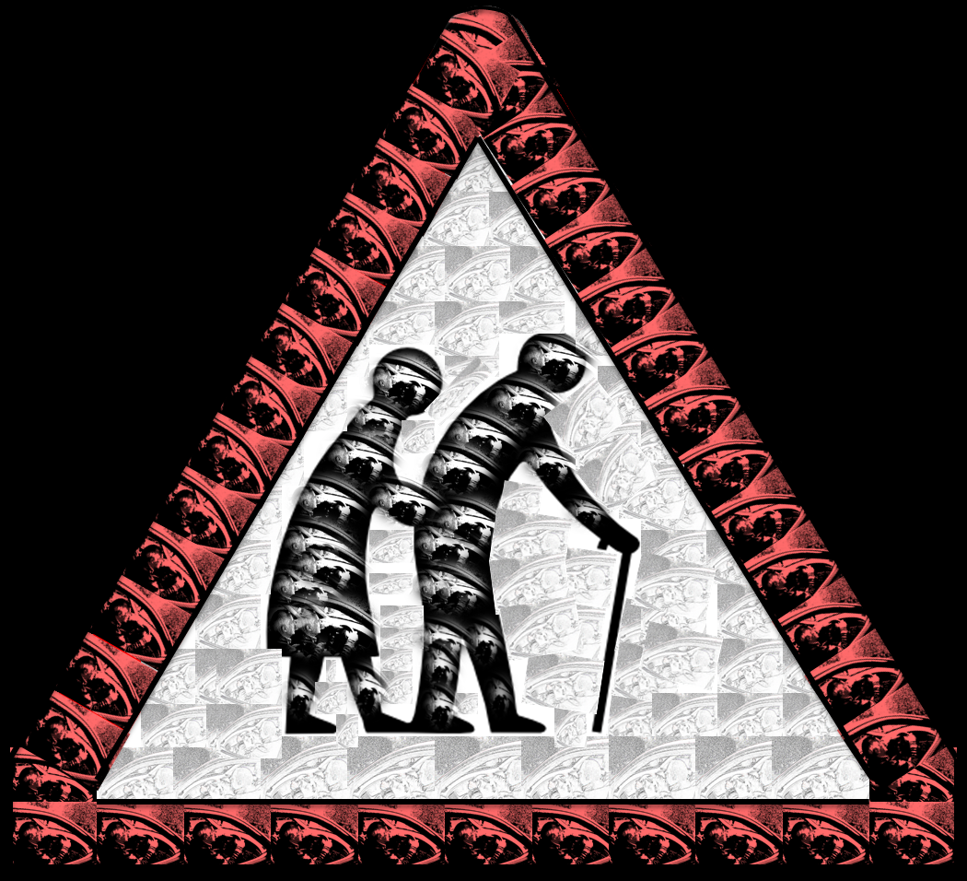
A reduction in mobility can result in an increase in isolation, loneliness and depression and an overall a poorer quality of life. (Fonda, et al., 2001; Ling and Mannion, 1995; Schlag, et al., 1996)

Slide 3
Older people are more healthy and active as a cohort than ever before and as such are also more mobile (Tomassini, 2004). Increasing hypermobile society, where services, shops, work and families are increasingly dispersed
Increasingly reliant on the car
Growth in % licence holders over 70 years
+37%
-8%
More miles driven per person
Source: DfT (2002, 2006, 2010)

Slide 4
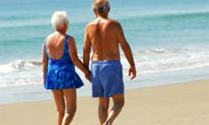
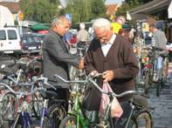
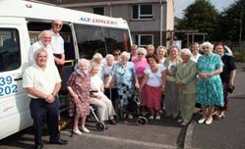
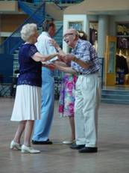
“You can’t ask other people to take you out for “a drive”. They’d think you’d lost their senses. Anyway they have got better things to be doing with their time, then ferrying me about just for the sake, like”
(female, gave-up driving at 80)
A reduction in mobility can result in an increase in isolation, loneliness and depression and an overall a poorer quality of life.
TERTIARY MOBILITY NEEDS
Aesthetic Needs
e.g. The need for the journey itself for relaxation, visit nature, use and test cognitive skills
Especially by car
On giving-up driving this level of needs is adversely affected
Not so easy to ask for discretionary travel
“It’s hard to explain I suppose. You just don’t seem like you belong. I suppose yes there are feelings that you might be ready for the scrapheap now. The first step to it, you know”
(Male, given-up driving at 76)
SECONDARY MOBILITY NEEDS
Social/affective Needs
e.g. The need for independence, control, to be seen as normal.
Linked to status, roles, identity, self-esteem. Impression management
On giving-up driving this level of needs is adversely affected
Isolation, no longer part of society, no longer feel normal
“Well Dorothy and David from number 3 take me shopping every week, we all go, we have a bit of a time of it you know, it’s a kind of outing. I never expected that. ” (Female, gave-up driving at 80)
W-H
PRIMARY MOBILITY NEEDS
Practical/utilitarian Needs
e.g. get from A to B as safely, reliably, cheaply and comfortably as possible.
On giving-up driving –
this level of need is usually met
friends
accessible transport
public transport
teleshopping?
Source: Musselwhite, C. and Haddad, H. (2010). Mobility, accessibility and quality of later life. Quality in Ageing and Older Adults. 11(1), 25-37.
Notes:
So why prolong the driving task for this age group. We already know that the number of drivers on our roads and the number of journeys on our roads are increasing, so shouldn’t we actually be trying to help this age group get out of their cars?
I believe that this is probably true, but only for the right reasons. We live in a society that is increasingly centred around the motor vehicle. As people get older they are beginning to cite an increase with difficulty in accessing services, especially as they are beginning to be cited out of town centres and away from residential zones.
Driving is linked with increased self-confidence, mastery (a sense of achievement) and self-esteem. In addition, feelings of autonomy, protection and prestige, all linked to a sense of control over the environment which as we know from psychological research is linked to maintaining both physical and mental health and indeed to prolonging life.
Needless to say, giving up driving is associated with an increase in depressive symptoms.
I believe that older people should be allowed to continue to drive motor vehicles, appropriately and for necessary journeys, for as long as possible and for as long as it is safe for them to do so.

Slide 5
Traditional Categorisation of Trip Purposes
Travel for Utility
Time wasted: to be minimised
Distance to be overcome
Destination-focussed
Routine
Often Essential, Productive
“Essential”
Economic
Priority
Travel for Tourism
Novel
Enriching
Less destination focussed
U T I L I T Y
Not
‘Transport’
“Discretionary”
Economic
Priority
Tourist

Slide 6
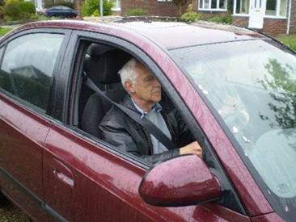
Prolong safe driving?

Slide 7
To consider...
Change the infrastructure
Self-explaining roads
Therefore in general terms, the more complex road environments are, the higher the accident involvement for older drivers.
‘Self-explaining’ roads which include perceptual cues are needed e.g.
“This is a ‘quick win’ area, in which many of the benefits are likely to extend beyond older drivers to the rest of the driving population”. (Box et al., 2011)
To help older people stay driving later on in their life, should we design an infrastructure to help them be safe?
Would it be a safer environment for everyone?

Slide 8
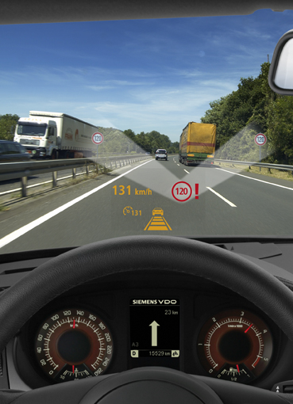
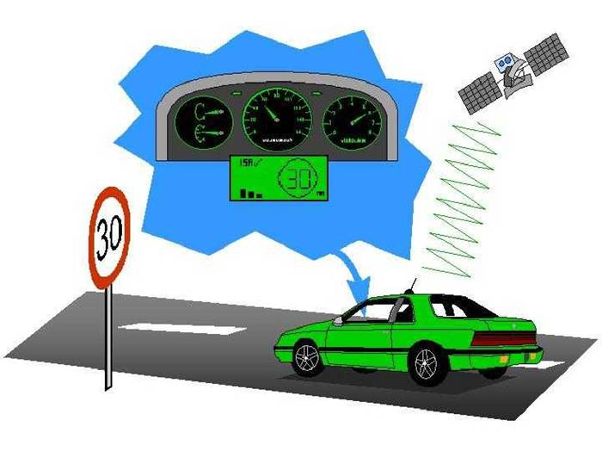
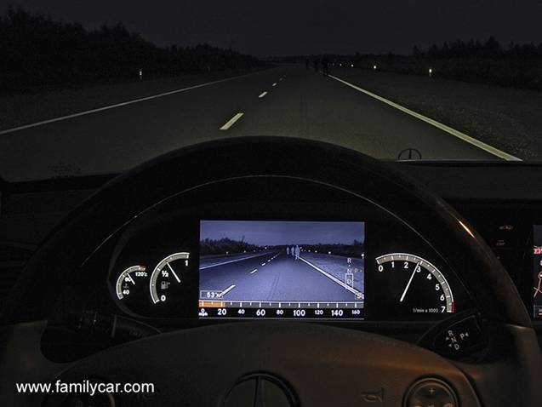
Change the vehicle
Increase the automation?
EXTERNAL DISTRACTIONS
Dashboard sign display (with user prioritisation)
Head-up sign display (with user prioritisation)
MAINTAINING A CONSTANT SPEED
Head-up display of current vehicle speed
Audible speed cue (driving speed)
Audible warning when reach actual speed limit
Intelligent Speed Adaptation
GLARE AND LUMINANCE
Night vision enhancement
Head-up display
Dashboard display
Musselwhite, C. and Haddad, H. (2008). Prolonging safe driving through technology. Final Report. UWE research report
Notes:
Dashboard sign display
Most preferred amongst older people
Head-up sign display
Most preferred option amongst car designers, technologists and academics.
Mixed dashboard & head-up has some support
User-prioritisation increases popularity.
Older people also advocate clearer signs and a change in legislation about amount of signs.

Slide 9
Change the law: Restrict driving
Re-take driving test
Stricter medical test
Retest elderly drivers to make sure they are still safe behind the wheel, new report urges
Number of older car users set to surge, report says
Grabowski et al (2004) | USA – | Vision tests, road tests, more frequent licence renewals, in person renewals no difference
Langford et al (2008) | Victoria (no age controls) and New South Wales (medical assessment 80+ and on road test 85+) | No sig diffs for older or other road users
Mitchell (2008) | Across Europe | lowest fatality rates for this age group occur in two of the countries (UK and the Netherlands) with more relaxed procedures
Siren and Meng (2012) | introduction of age-based cognitive screening starting from the age of 70 in Denmark in May 2006, in a population-based study. | Whilst collision rates for car drivers did not significantly change across any age group. the collision rate for older vulnerable road users in the post-implementation period increased significantly: by 38%.
Langford et al., (2004). | In Sydney (where there is mandatory assessment from 80 years onwards) and Melbourne (in which there are no age-based controls) | older drivers in Sydney (with age-based controls) had higher collision risks per licence and per times spent driving than those in Melbourne (who had no controls).
Elderly drivers should be banned from motorways, says road safety charity
No to extra tests
Other than for prompting
Self-regulation?
Works well, but the future with working later? More car centric society?

Slide 10
Change the driver
Education:
Improves self-awareness
Training, education
Feedback from others, the environment, cars
How to improve self-awareness
Cognitive tests
On-road tests
Classroom/group work
Role of ADIs
Physiological test?
Cognitive tests
On-road tests
Course
Must allow self-reflection
Must allow chance for fail
Must encourage strategies to adopt to help self-regulation
Must provide help with alternatives
Involve Forum of Mobility Centres
Look for champions and leaders
AA Drive Tech
Wessex DriveAbility
But how aware are you in wider social context?
Who would want to be educated?
Who would bear the cost?
Who would attend?
Age discrimination?
Do the courses work?
Evidence?
How would the evidence look?
Musselwhite, C.B.A. (2010). The role of education and training in helping older people to travel after the cessation of driving International Journal of Education and Ageing 1(2) , 197-212 Musselwhite, C. (2011) Successfully giving up driving for older people. Discussion Paper. International Longevity Centre - UK.

Slide 11
Leaving the vehicle behind

Slide 12
Help with giving-up driving
Successful at giving-up driving
Plan in advance
“I’ve re-discovered my local area. Which is great. I forgot what the village has to offer. In fact I think it is better than a few years ago. But not using the car has forced me to use more local things.” (female, aged 75)
Trial and error
“The bus out is a real bit of fun. I go on it with friends... and we have a day out” (female, aged 70)
Support of family and friends
Multimodal
Re-engage in immediate locale
Literal
Potential
Virtual
Imaginative
Musselwhite, C.B.A. and Shergold, I. (2013). Examining the process of driving cessation in later life. European Journal of Ageing. 10(2), 89-100

Slide 13
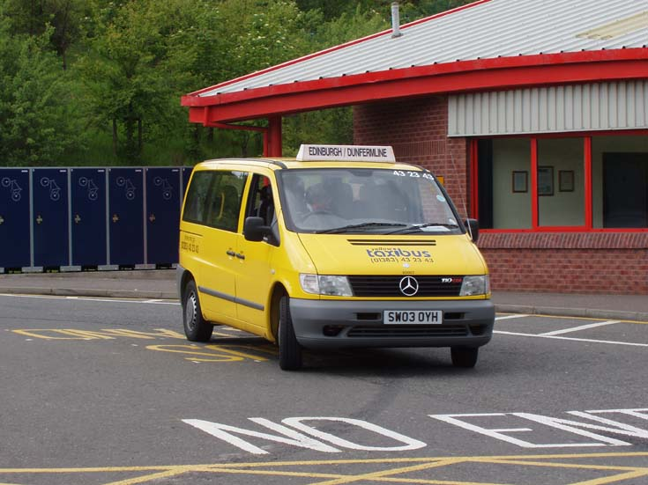
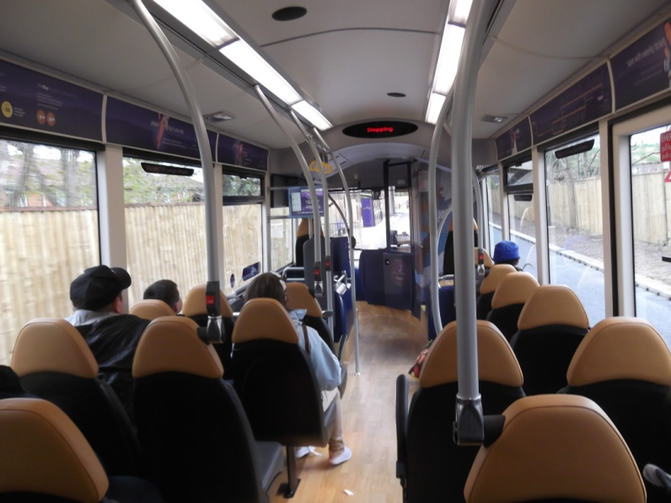
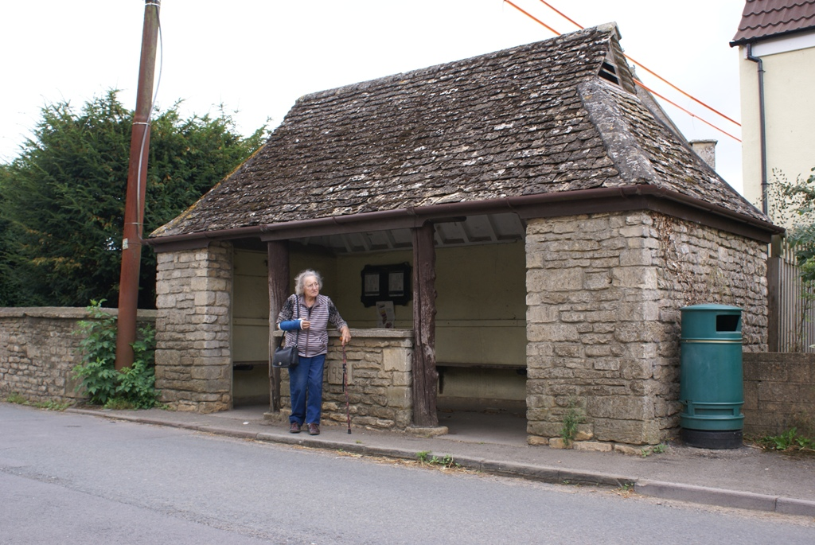
Improving bus use
Formal information
Alternative transport provided locally
Timetable of buses
Location of bus stops
Walking area
Real time information
Informal information
Does the bus leave when it says it does?
Ease of carrying shopping/luggage on a bus?
Ease of getting a seat on a bus?
State of the pavements for walking?
Provision of benches, formalised crossing areas, toilets etc.
Feeling of safety using transport/walking?
Attitude of bus driver
Bus use
Unprecedented cuts in services
Growth of community transport
Issues:-
Must communicate the benefits of free bus pass
Wider economic and social benefits to individuals and society
Need to map return on investment
Quality of service
For aesthetic purposes – just getting out and about
Musselwhite, C.B.A. (2010). The role of education and training in helping older people to travel after the cessation of driving International Journal of Education and Ageing 1(2) , 197-212

Slide 14
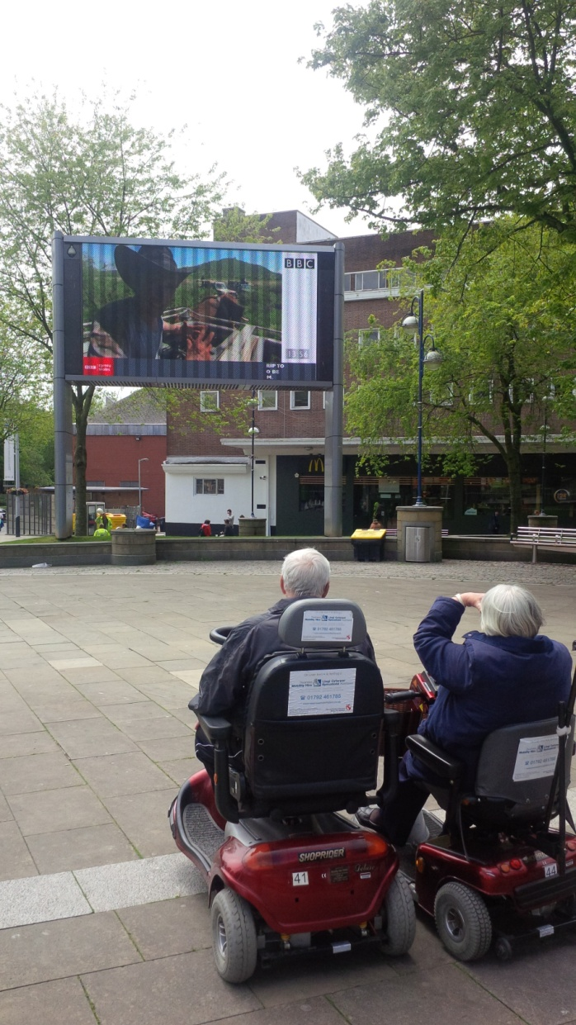
The role of mobility scooters
It is estimated there are around 300,000 mobility-scooter users in the UK
(DfT, 2010c).
Very positively received by users as they help maintain freedom and independence (e.g Barham et al., 2006; DfT, 2010c; Steyn and Chan, 2008).
Issues:-
Who uses them?
Insurance and safety?
But do they replace walking and effect health?
Thoreux (2011) perform worse than non-users.

Slide 15
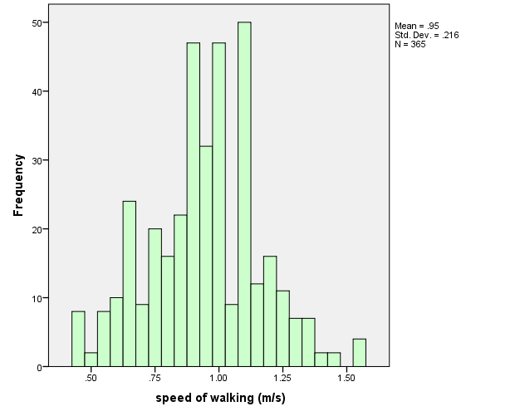
Walking
Only 11% walk as fast or faster than DfT recommendations for pedestrian crossing time
Only 6% of females
Faster if higher socio-economic background, healthy and confident
Agrees with previous research (Asher et al., 2012, Newton and Omerod, 2007).
fear of not being quick enough to cross the road is known to restrict people leaving the home or limit their accessibility when out and about (IDGO 2013; Lord et al., 2010; Zijlstra, 2007).
Make streets attractive
TERTIARY TRAVEL NEEDS
Aesthetic Needs
Pleasantness/desirability of neighbourhood open spaces (trees, plants, waterscapes)
DfT Minimum crossing speed 1.22m/s (88% not walking fast enough!)
SECONDARY TRAVEL NEEDS
Social Needs
A place to make a statement and interact e.g. suitable spaces to socialize. Inter-generational community important
PRIMARY TRAVEL NEEDS
Practical Needs
Large, open, un-crowded, low level of noise. Lack of nuisance.
Well maintained paths for movement. Facilities and amenities.
Musselwhite, C.B.A. (2014). Environment-person interactions enabling walking in later life Proceedings of the 46th Annual UTSG Conference, Transport Operations Research Group, Newcastle University, 6th January

Slide 16
Conclusion

Slide 17
Transport is more than just A to B
Provision beyond the car must reflect diverse patterns of travel and individual need.
How to help break the giving-up driving = poorer health and wellbeing correlation
Integration: within travel training, within provision and services.
Multimodality from a young age.
Increasing need to prove mobility is important (and the wider economic and social benefits).
Future:
Novel solutions. ITN America.
Re-inventing existing solutions: Taxis/cycling
Milton Keynes Pods
Nature of working later? Health and fitness of society? Falling out of love with the car? Will we even have cars?
Role of Virtual mobility?

